Slide 1
Geometric Data and Representation
Pattern Recognition 2015/2016
Marc van Kreveld

Slide 2
Topics this lecture
What are the main geometric data formats?
How is data collected?
How can we convert one format into another?
How are basic geometric computations done?
What additional issues do we get from spatially aggregated data?
Notes:
- raster, vector, point sets 2d and 3d, shapes (polygons, polyhedra), planar subdivisions, trajectories
- scanning, etc.
- raster-vector conversion: edge detection, gradients, line simplification methods
intersection, circle through 3 points, etc.
aggregated data

Slide 3
Geometric data formats
Raster (pixel, voxel) structure
Subdivision, nominal
2D or 3D point set, point cloud
Surface mesh (triangles)
Various formats
Volumetric mesh (tetrahedra)
Scalar field
Points with measurements
Gridded Digital Elevation Model (DEM)
Triangular Irregular Network based model (TIN)
Vector field

Slide 4
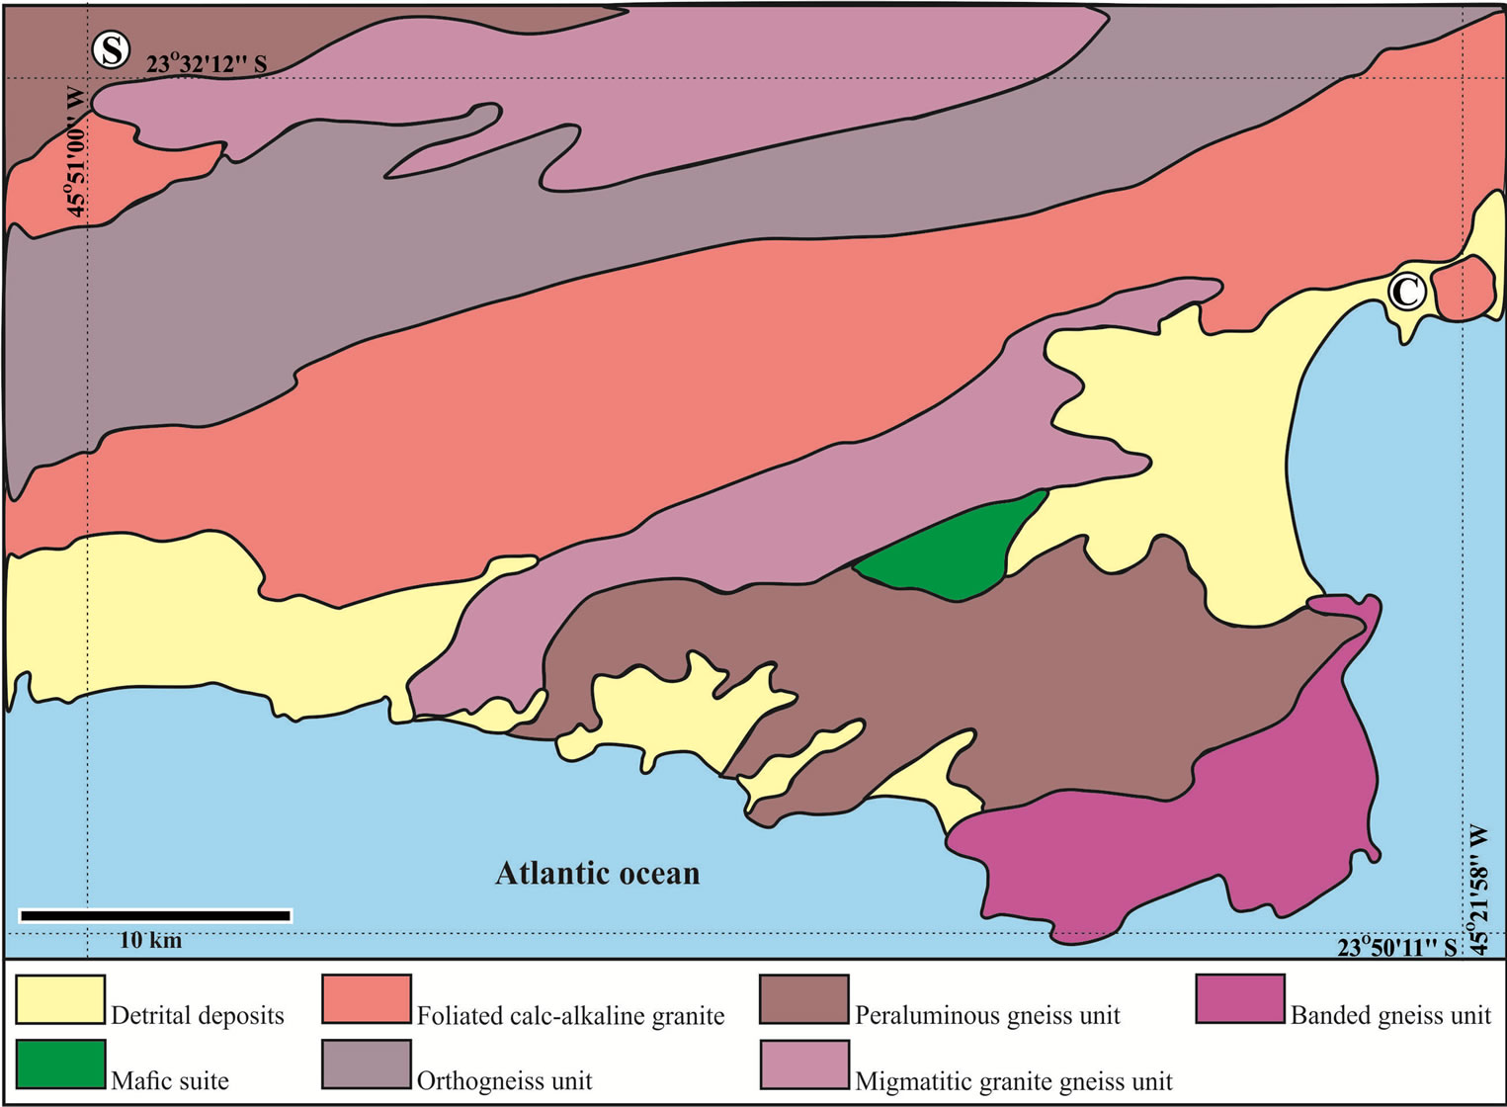
Notes:
Geological map

Slide 5
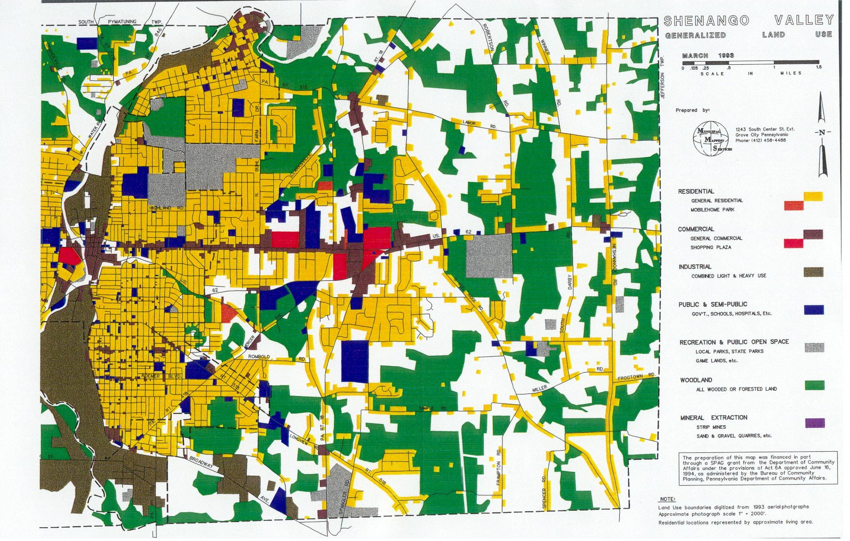

Slide 6
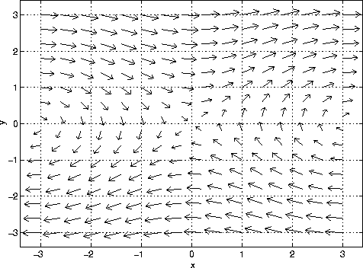
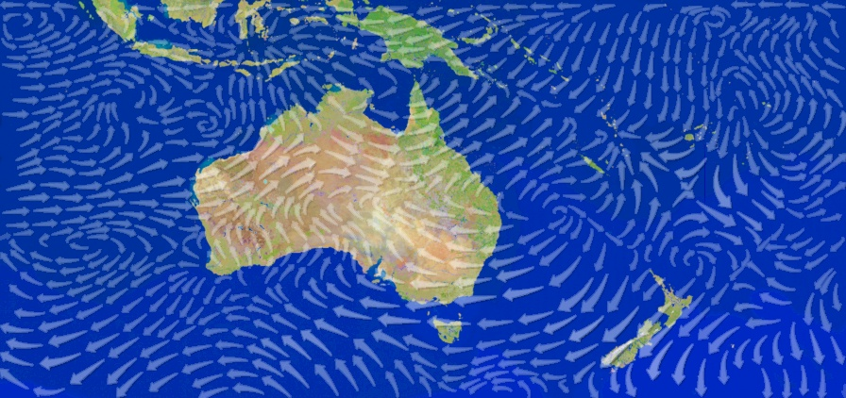

Slide 7
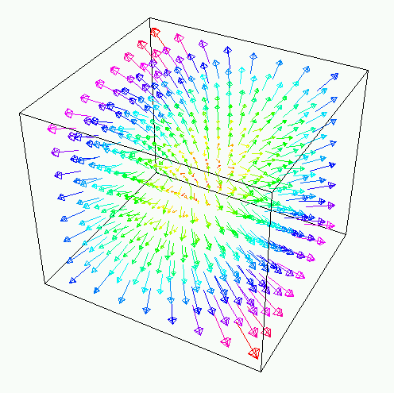
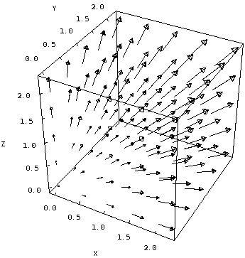

Slide 8
Data acquisition
Scanning, airborne or ground-based
Additional: location of scanner → unobstructed scan line segment
Stereo imaging, SIFT points
Ground measurements
GPS, RFID, sensors

Slide 9
Raster-to-vector conversion
Raster-to-vector: Consider pixel sides between pixels with different values as boundary and put in vector representation
Edge detection, tracing
Thinning
Line simplification

Slide 10
Tracing and thinning
Tracing edges
Thinning

Slide 11
Line simplification
Douglas-Peucker algorithm from 1973
Input: chain p1, …, pn and error ε
ε
p1
pn

Slide 12
DP-algorithm
ε
Draw line segment between first and last point
If all points in between are within error: ready
Otherwise, determine farthest point and recursively continue on the part until farthest point and the part after farthest point

Slide 13
DP-algorithm
DP-standard(i, j, ε)
Determine farthest point pk between pi and pj
If distance(pk, pi pj) > ε then DP-standard(i, k, ε)
DP-standard(k, j, ε)
Return the concatenation of
the simplifications

Slide 14
ε
ε
ε

Slide 15
ε
ε
ε

Slide 16
Properties of the DP-algorithm
DP-algorithm does not minimize the number of points in the simplification
ε
ε
ε
DP-algorithm
Optimal

Slide 17
Properties of the DP-algorithm
Determining farthest point takes O(n) time
Whole algorithm takes T(n) = T(m) + T(n-m+1) + O(n), T(2) = O(1) time, splitting in m and n-m+1 points
“Fair” split gives O(n log n) time
Worst case gives quadratic time

Slide 18
Properties of the DP-algorithm
DP-algorithm may give self-intersections in the output
ε
Solution: test output for self-intersections and continue adding control points if necessary

Slide 19
Improved DP-algorithm
DP-improved(i, j, ε)
Simp = DP-standard(i, j, ε)
V = set of intersecting segments of Simp Repeat
For all segments s ∈ V : Refine(s) in simplification Do one refinement à la DP by adding the farthest point (even though it was at most ε away)
and check the ε-condition again. If necessary,
repeat this step until the ε-condition is fulfilled V = set of intersecting segments of simplification Until V is empty
Notes:
It can happen that a polygonal line is approximated within eps, but by forcing one extra DP step, it no longer is within eps

Slide 20
Improved DP-algorithm
No intersections
Not optimal in resulting no. of vertices
With some effort a running time of O(n² log n) can be realized

Slide 21
Imai-Iri line simplification
Based on first computing valid shortcuts
Euclidean distance vertices – line segment ≤ ε

Slide 22
Imai-Iri line simplification
Based on first computing valid shortcuts
Euclidean distance vertices – line segment ≤ ε

Slide 23
Imai-Iri line simplification
Based on first computing valid shortcuts
Euclidean distance vertices – line segment ≤ ε

Slide 24
Imai-Iri line simplification
Based on first computing valid shortcuts
When we have the graph with all edges and allowed shortcuts, apply Dijkstra’s shortest path algorithm

Slide 25
Imai-Iri line simplification
The graph can have ~n² edges; testing one shortcut takes time linear in the number of vertices in between
The Imai-Iri algorithm avoids spending ~n³ time by testing all shortcuts from a single vertex in linear time

Slide 26
Efficiency
The graph can have ~n² edges; testing one shortcut takes time linear in the number of vertices in between
The Imai-Iri algorithm avoids spending ~n³ time by testing all shortcuts from a single vertex in linear time

Slide 27
More data conversion
Planar point set to polygon/set of polygons representation
Example case: Determine whether underground ore fields are elongated Data: borehole measurements revealing whether the ore is there or not
no ore
ore

Slide 28
More data conversion
Point cloud to boundary mesh representation = 3D reconstruction
Example case: For a 3D model of a house, determine whether a house of that size and shape occurs Data: point cloud of an urban scene
Notes:
We have three options: (1) we match the house to the point cloud; (2) we sample the house to be a point cloud too and we find an occurrence of such a small point cloud in the big one; (3) we reconstruct the urban scene from the point cloud and we find the 3D model in the urban scene model

Slide 29
Basic geometric computations
Intersection of two line segments
Circle through three points
Distance between a point and a line segment
Containment of a point in a triangle
3D versions of such operations

Slide 30
Basic geometric computations
Intersection of two line segments
Circle through three points
Distance between a point and a line segment
Containment of a point in a triangle
3D versions of such operations Such computations require some effort, but in the end, they are straightforward, and probably provided in a library

Slide 31
Aggregated data
Sometimes data is available only in aggregated form, for example due to privacy reasons
Income is not made public at the household level
AIDS cases are not made public by address
Aggregated data of addresses would be by postal codes (just 4 digits, or 4 digits plus 2 letters)
E.g., average household income at 3521 DA is 56,000
E.g., number of AIDS cases in 3732 .. is 9

Slide 32
Aggregated data
Aggregation may make finding patterns impossible
Located occurrences of a rare disease
0 - 1
2 - 4
5 -
Aggregation boundaries have got nothing to do with mapped theme
clustering?

Slide 33
Aggregated data
Aggregation and mapping may be deceiving
Located occurrences of a rare disease
0 - 1
2 - 4
5 -
Need to compensate for population density
clustering?

Slide 34
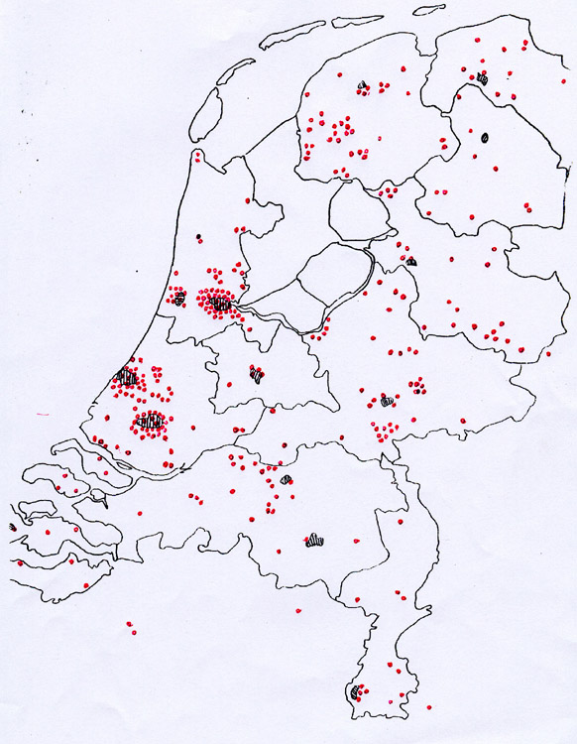
Huntington’s disease,
1800-1900
Notes:
Obviously, there are more cases of a disease where there are more people. The figure does not show clustering at all (quite the opposite).

Slide 35
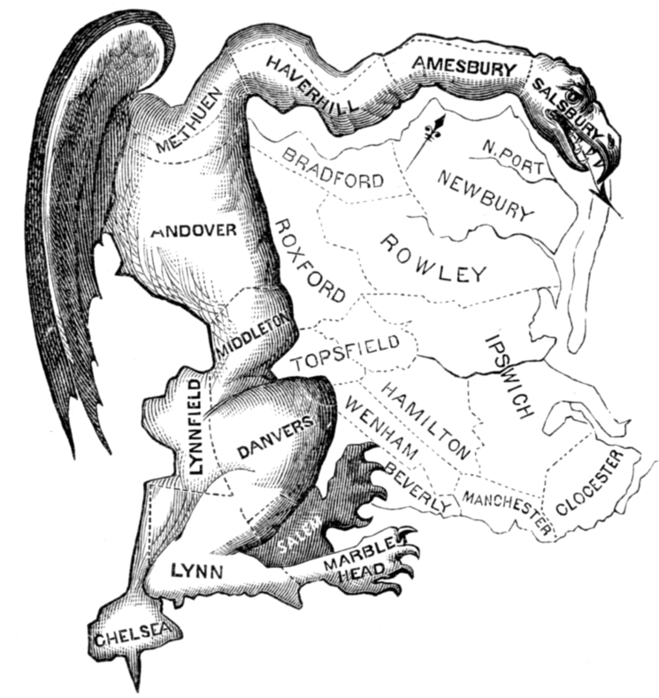
Aggregated data
Aggregated data gives rise to the Modifiable Areal Unit Problem (MAUP), a major issue in geographical analysis
Closely related example: you can win the US presidential elections with about 25% of the votes
Gerrymandering

Slide 36
Summary
Geometric data comes in vector (object) form and in raster (image) form
Data may be aggregated into meaningful or not so meaningful units
Data sources and acquisition determine the initial form
Data conversion may involve (polygonal) line simplification

